Slide 1
Machine Learning Model
Solutions, for
Defaulters
And Non-Defaulters
Classifications
Aug 20, 2023
Presented By
Victor Lee CW
© 2023 Bajaj Finserv & Company. All rights reserved.

Slide 2
01
Current Lenders Situation/Problem Overview
02
Historical Dataset Analysis
03
Data Understanding
Datatypes of each variable
04
Data Preparation
Missing Data Check,
Bool to int64, decimal to percent
Conversion of DateTime format,
Splitting of dates and convert to int64
TABLE OF CONTENTS
05
EDA – Exploratory Data Analysis
Analyze of Categorical variable vs Default Status
06
Numerical Variable Skewness Check
07
Data Binning
08
FE – Label Encoder / OneHot Encoder
09
Splitting of Dataset , Training and Testing
10
Machine Learning Models Comparison

Slide 3
Current Lenders Situation/Problem Overview
Case Study:
In order for the financial industry to maintain a healthy lending portfolio,
it is crucial for lenders to assess the creditworthiness of borrowers before granting loans or credit,
and this can help mitigate financial losses by identifying potential defaulters, who are at higher risk
of failing to repay their debts.

Slide 4
Historical Datasets Analysis
Research Objective:
From the company, Banjaj Finserv, that provided the historical datasets that contains different feature details like Loan Type, Loan Amount, Interest Rate, Loan Term, Credit Score, etc. , the goal of this project is to develop a predictive model that can accurately classify borrowers as defaulters or non-defaulters based on various financial and demographics factors .

Slide 5

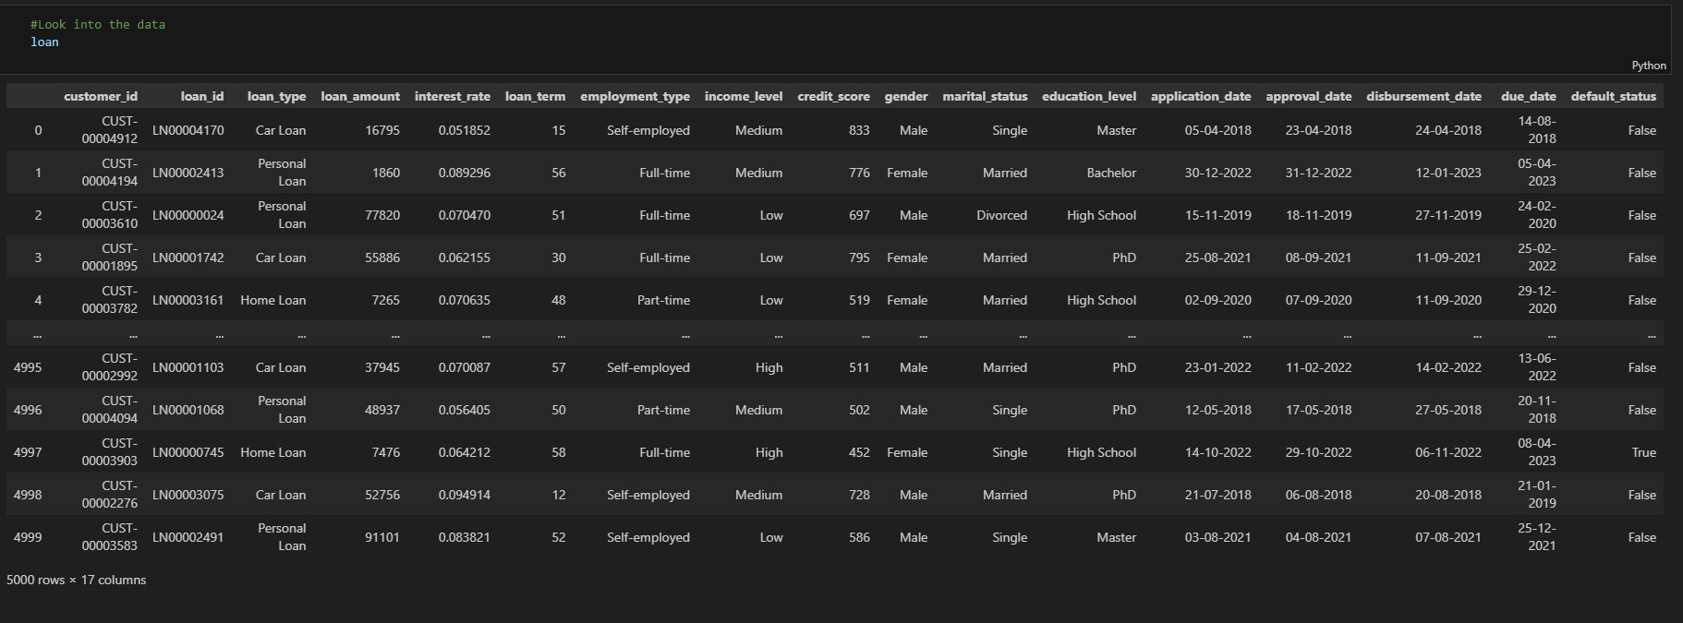
Data Understanding
Dataset Features: 5000 rows x 17 columns

Slide 6
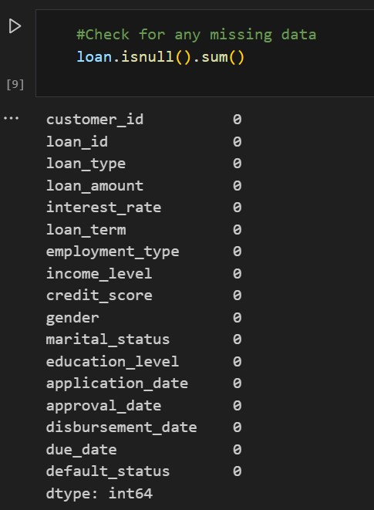
Data Preparation
Missing Data Check

Slide 7
Data Understanding
Dataset Features: 5000 rows x 17 columns
Data Types | Variables | Format
Categorical data (qualitative) | customer_id, loan_id, loan_type, employment_type, income_level, gender, marital_status, education_level default_status | object (8) boolean (1)
Numerical data (quantitative) | loan_amount, loan_term, credit_score interest_rate | int(64) (3) float(64) (1)
DateTime | application_date, approval_date, disbursement_date, due_date | object (4)

Slide 8
Data Preparation
default_status from boolean to integer,i.e false =0, true=1
interest_rate from decimal to percent, i.e. x100 and round to 1 decimal place
To convert all columns with dates from object to datetime64 format

Slide 9
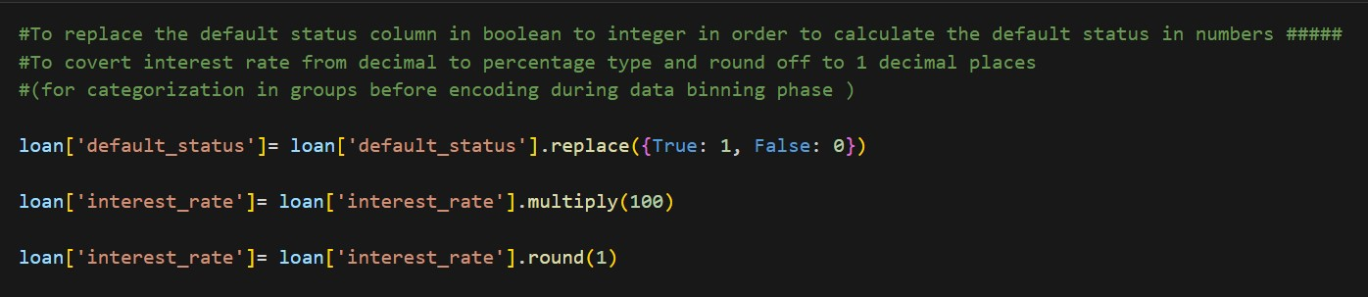
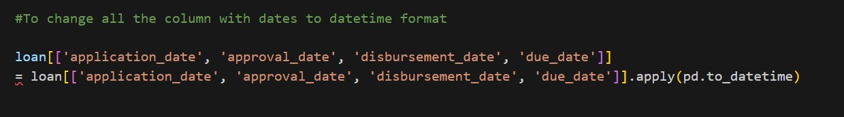
Data Preparation

Slide 10
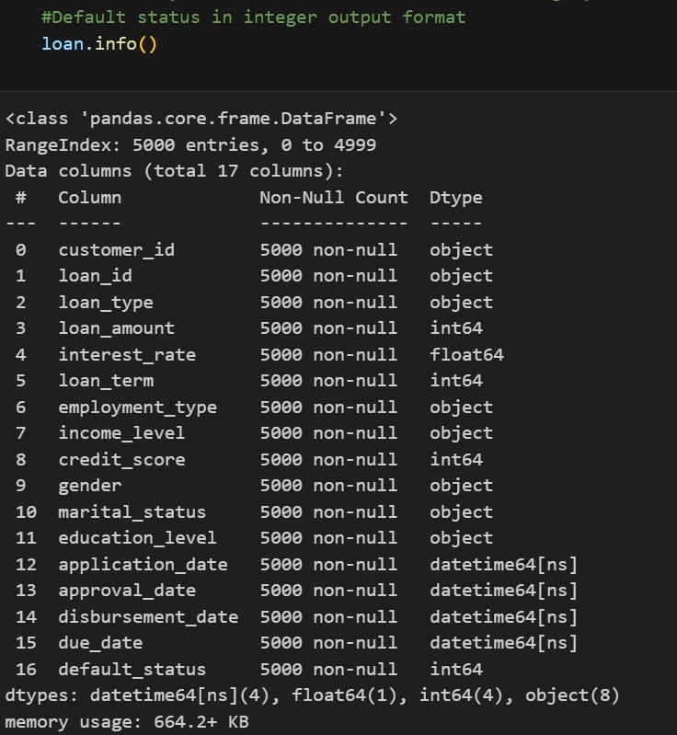
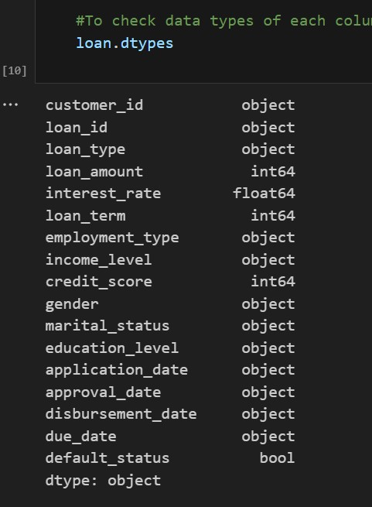
Data Preparation

Slide 11
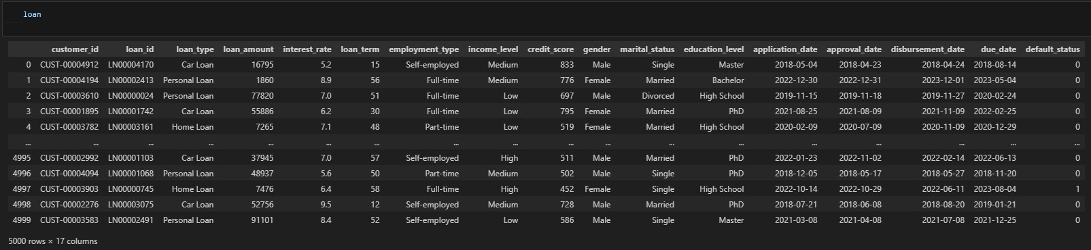
Dataset Preparation
After convert for default_status, column dates and interest_rate

Slide 12

#Although all the dates are in datetime64 format for Pandas datatypes from object now, we need to convert it into integers for the ML algorthims to have a predictive accuracy.
#Break apart the date and get the year, month, week of year, day of month and day of week.
loan['application_date_year'] = loan['application_date'].dt.year
loan['application_date_month'] = loan['application_date'].dt.month
loan['application_date_week'] = loan['application_date'].dt.week
loan['application_date_day'] = loan['application_date'].dt.day
loan['application_date_dayofweek'] = loan['application_date'].dt.dayofweek
loan['approval_date_year'] = loan['approval_date'].dt.year
loan['approval_date_month'] = loan['approval_date'].dt.month
loan['approval_date_week'] = loan['approval_date'].dt.week
loan['approval_date_day'] = loan['approval_date'].dt.day
loan['approval_date_dayofweek'] = loan['approval_date'].dt.dayofweek
loan['disbursement_date_year'] = loan['disbursement_date'].dt.year
loan['disbursement_date_month'] = loan['disbursement_date'].dt.month
loan['disbursement_date_week'] = loan['disbursement_date'].dt.week
loan['disbursement_date_day'] = loan['disbursement_date'].dt.day
loan['disbursement_date_dayofweek'] = loan['disbursement_date'].dt.dayofweek
loan['due_date_year'] = loan['due_date'].dt.year
loan['due_date_month'] = loan['due_date'].dt.month
loan['due_date_week'] = loan['due_date'].dt.week
loan['due_date_day'] = loan['due_date'].dt.day
loan['due_date_dayofweek'] = loan['due_date'].dt.dayofweek

Slide 13
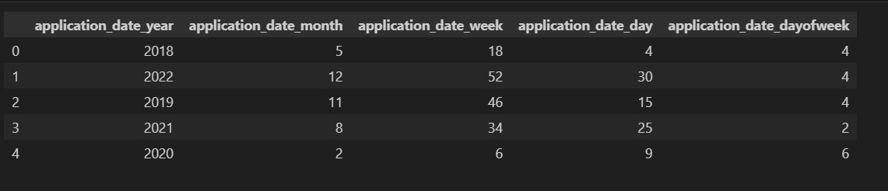
#To verify if the conversion dates works:
loan[['application_date_year', 'application_date_month', 'application_date_week', 'application_date_day', 'application_date_dayofweek']].head()

Slide 14
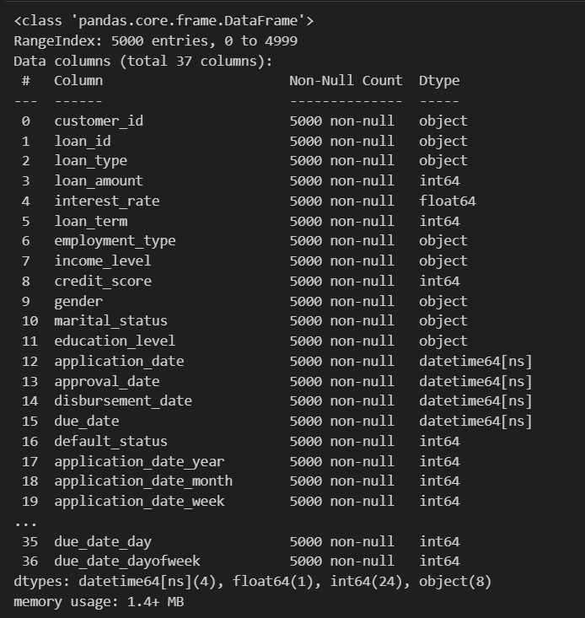
#To check if all the breakdown dates is in integer data type
loan.info()

Slide 15

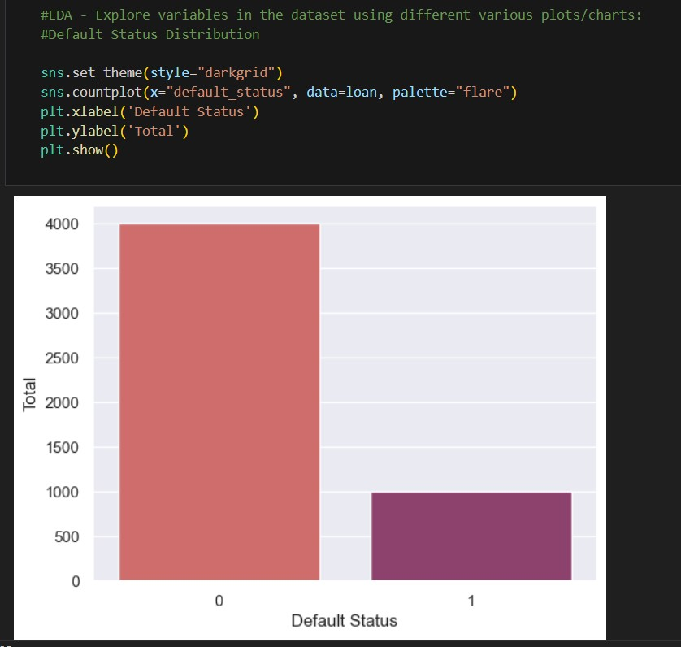
Exploratory Data Analysis – default_status
# To analyse the catergorical variables- Default Status
# The number of defaulters are much lower (4 times) than the non-defaulters
loan.default_status.value_counts()

Slide 16
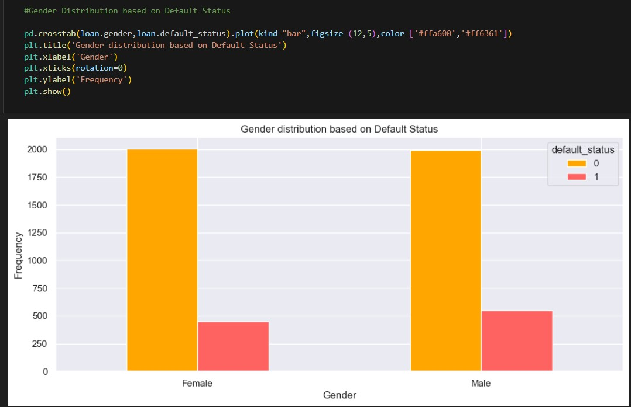

Exploratory Data Analysis – gender
# To analyse the catergorical variables- Gender
# The Male gender has a higher distribution number than the Female
loan.gender.value_counts()

Slide 17
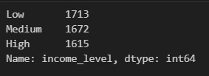
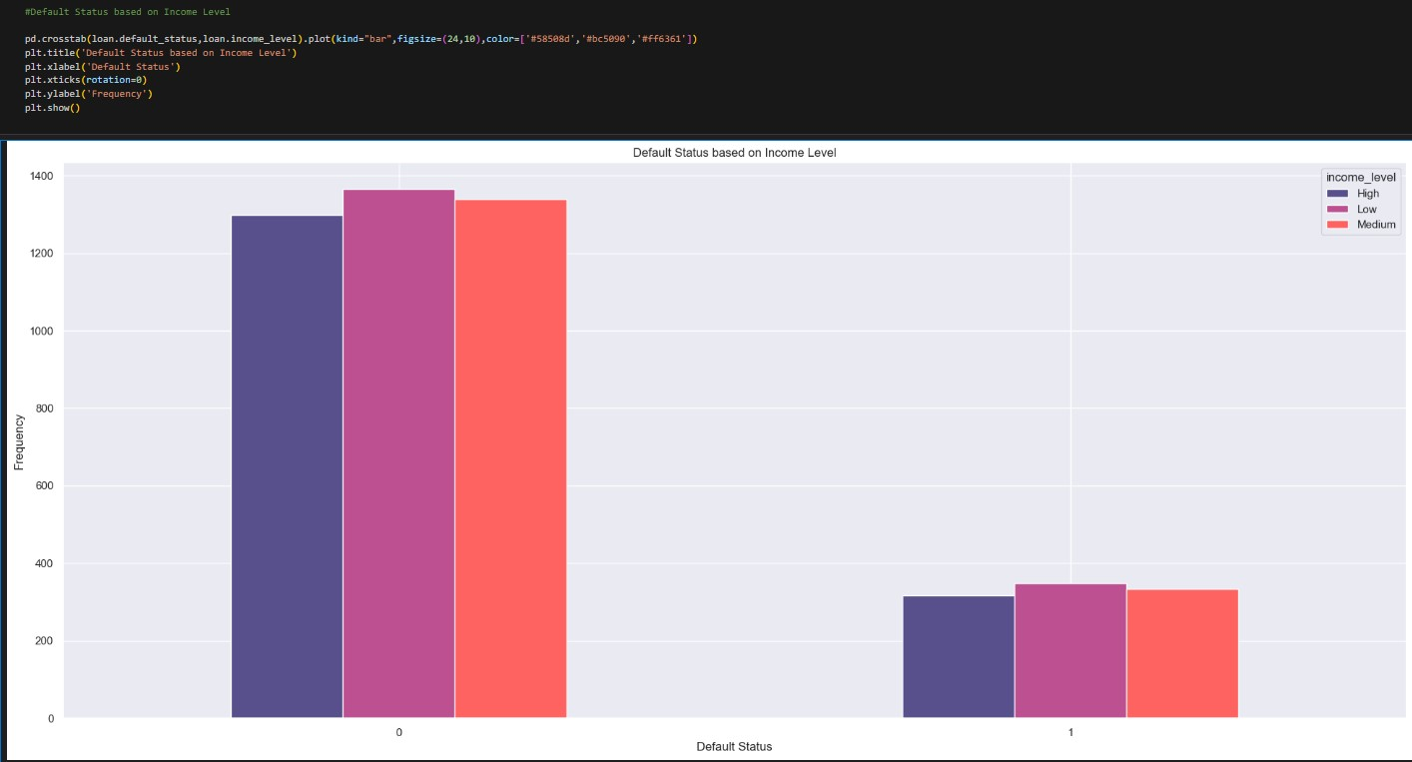
Exploratory Data Analysis – income_level
# To analyse the catergorical variables- Income Level
# Below shows the low income level has a higher distribution number than the other two

Slide 18
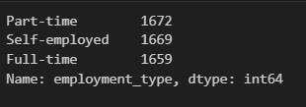
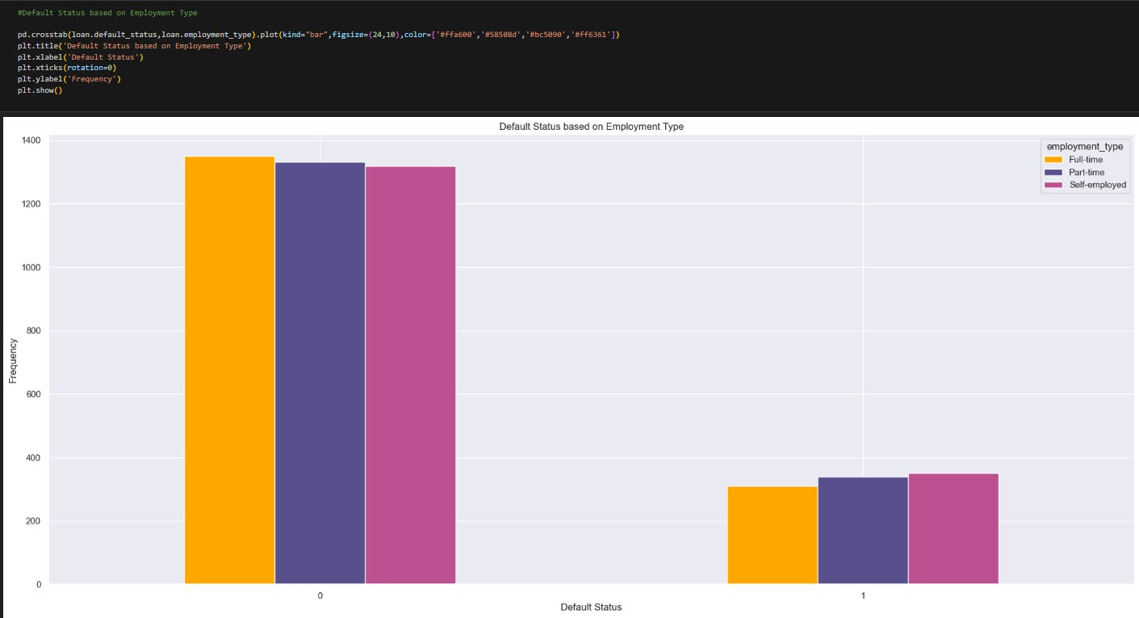
Exploratory Data Analysis – employment_type
# To analyse the catergorical variables- Employment Type
# The distribution of Employment type is balanced
loan.employment_type.value_counts()

Slide 19
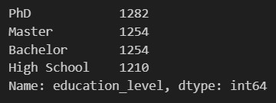
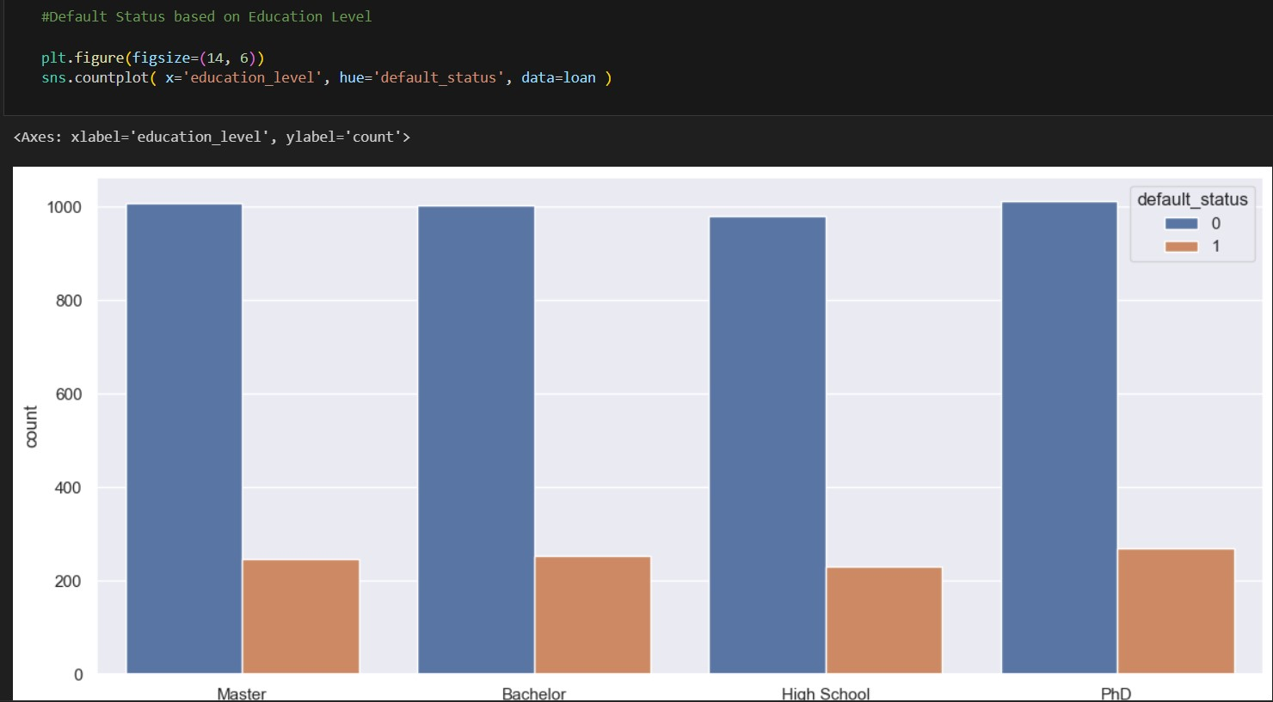
Exploratory Data Analysis – education_level
# To analyse the catergorical variables- Education Level
# The PhD has a slightly higher distribution number than the other level
loan.education_level.value_counts()

Slide 20
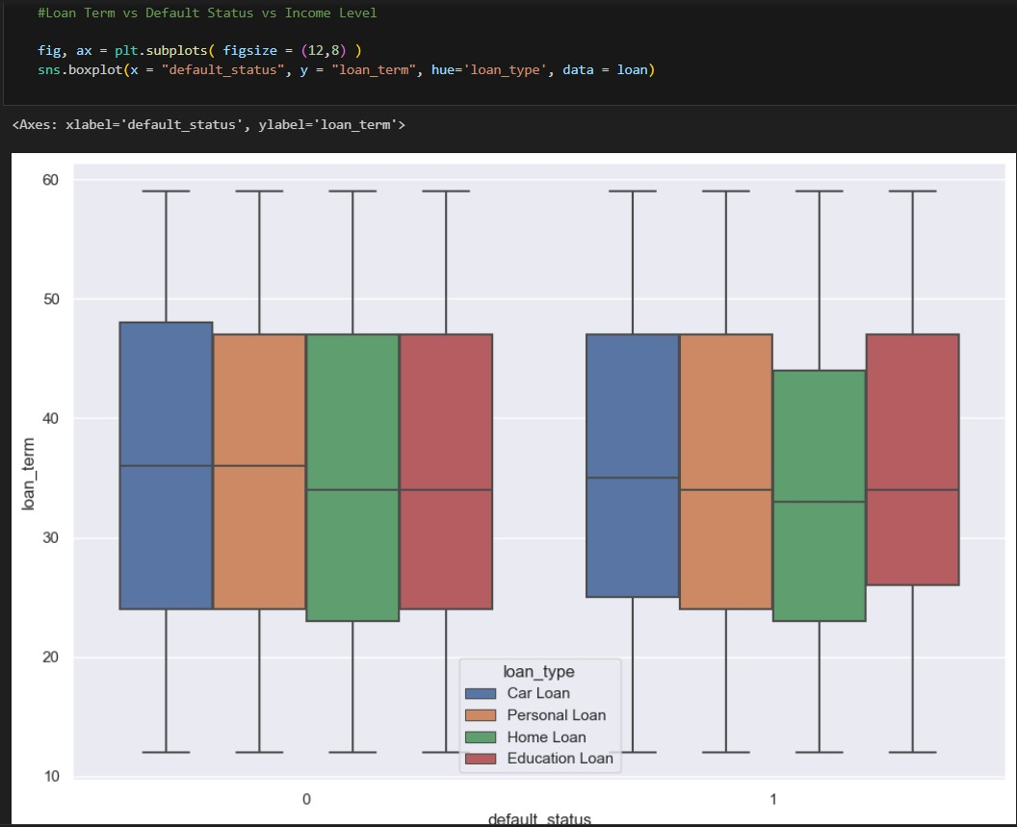
Exploratory Data Analysis – loan_type vs loan_term
#Loan Term vs Default Status vs Loan Type
fig, ax = plt.subplots( figsize = (12,8) )
sns.boxplot(x = "default_status", y = "loan_term", hue='loan_type', data = loan)

Slide 21

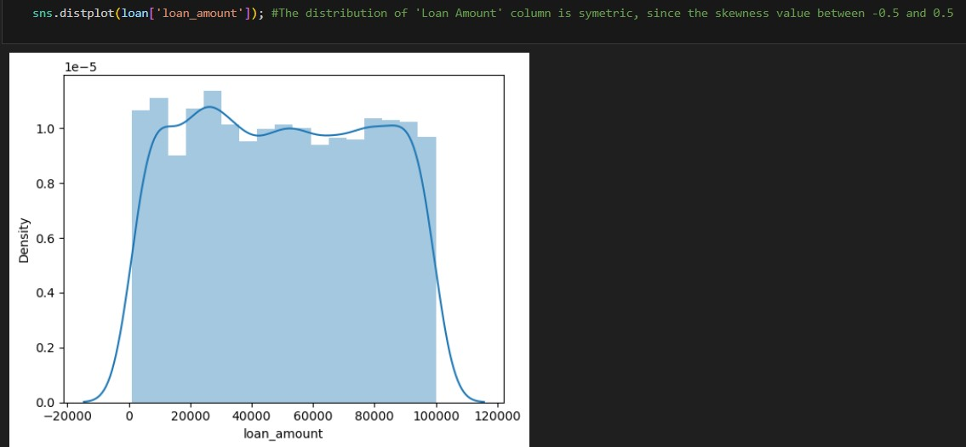
Numerical Variable Skewness – loan_amount
#To check the skewness of each Numerical variable :
# Loan Amount
skewLoanAmount = loan.loan_amount.skew(axis = 0, skipna = True)
print('Loan Amount skewness: ', skewLoanAmount)

Slide 22
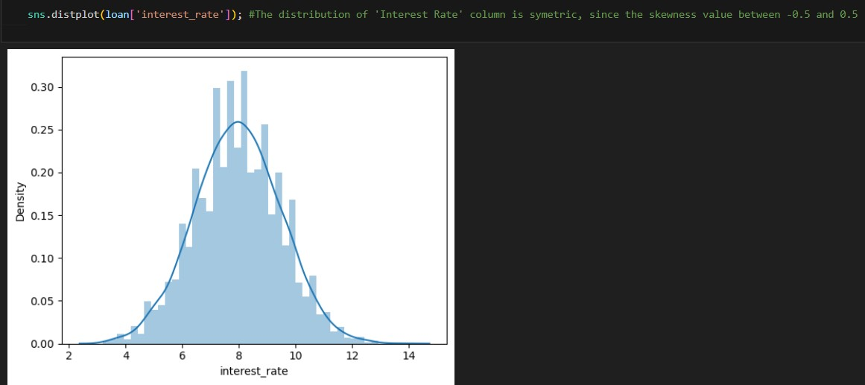
Numerical Variable Skewness – interest_rate
#Interest Rate
skewInterestRate = loan.interest_rate.skew(axis = 0, skipna = True)
print('Interest Rate skewness: ', skewInterestRate)

Slide 23

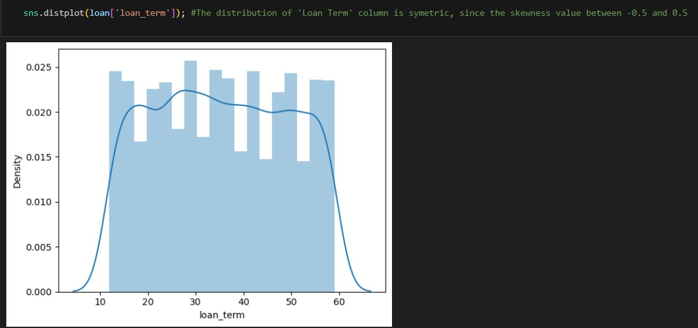
Numerical Variable Skewness – loan_term
#Loan Term
skewLoanTerm = loan.loan_term.skew(axis = 0, skipna = True)
print('Loan Term skewness: ', skewLoanTerm)

Slide 24

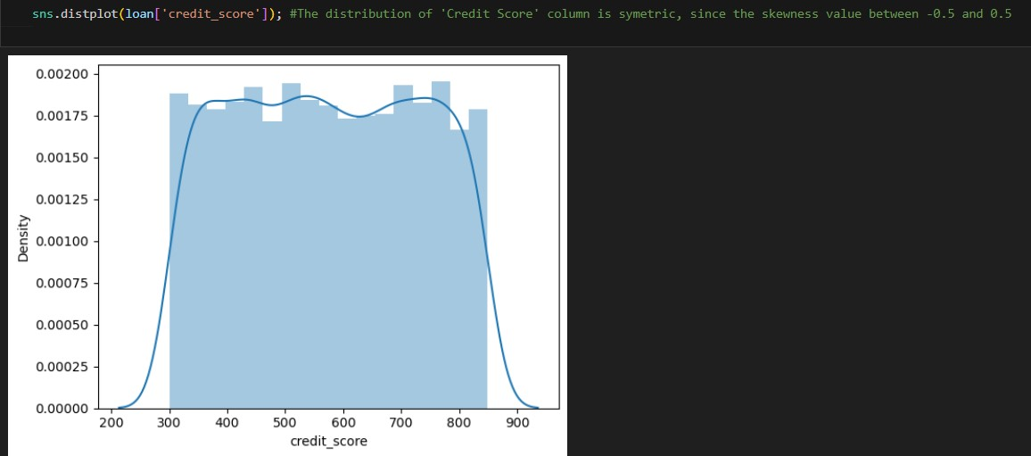
Numerical Variable Skewness – credit_score
#Credit Score
skewCreditScore = loan.credit_score.skew(axis = 0, skipna = True)
print('Credit Score skewness: ', skewCreditScore)

Slide 25
Data Binning - loan_amount, interest_rate, loan_term, credit_score
# Data Binning:
# Loan Amount will be divided into 18 categories each
bin_LoanAmount = [1055, 1999, 2999, 3999, 4999, 5999, 6999, 7999, 8999, 9999, 19999, 29999, 39999, 49999, 59999, 69999, 79999, 89999, 99989]
category_LoanAmount = ['1000-2000', '2000-3000', '3000-4000', '4000-5000', '5000-6000', '6000-7000', '7000-8000', '8000-9000', '9000-10000', '10000-20000', '20000-30000', '30000-40000', '40000-50000', '50000-60000', '60000-70000', '70000-80000', '80000-90000', '>90000']
loan['loan_amount_binned'] = pd.cut(loan['loan_amount'], bins=bin_LoanAmount, labels=category_LoanAmount)
loan = loan.drop(['loan_amount'], axis = 1)
#Interest Rate will be catergorised into 11 catergory
bin_InterestRate = [3, 3.9, 4.9, 5.9, 6.9, 7.9, 8.9, 9.9, 10.9, 11.9, 12.9, 13.8]
category_InterestRate = ['3-4', '4-5', '5-6', '6-7', '7-8', '8-9', '9-10', '10-11', '11-12', '12-13', '>13']
loan['interest_rate_binned'] = pd.cut(loan['interest_rate'], bins=bin_InterestRate, labels=category_InterestRate)
loan = loan.drop(['interest_rate'], axis = 1)
# Loan Term will be divided into 5 categories each
bin_LoanTerm = [12, 19, 29, 39, 49, 59]
category_LoanTerm = ['10-20', '20-30', '30-40', '40-50', '>50']
loan['loan_term_binned'] = pd.cut(loan['loan_term'], bins=bin_LoanTerm, labels=category_LoanTerm)
loan = loan.drop(['loan_term'], axis = 1)
# Credit Score will be divided into 6 categories each
bin_CreditScore = [300, 399, 499, 599, 699, 799, 849]
category_CreditScore = ['300-400', '400-500', '500-600', '600-700', '700-800', '>800']
loan['credit_score_binned'] = pd.cut(loan['credit_score'], bins=bin_CreditScore, labels=category_CreditScore)
loan = loan.drop(['credit_score'], axis = 1)

Slide 26
Data Binning – Application (Weeks, Days, Months, DayOfWeek)
# Data Binning on Dates:
# The four dates: Application/Approval/Disbursement/Due will not be using years as it is not predicting the future years,
# will be using Weeks(1-53), Days(1-31), Months (1-12) and DayOfWeek (0-6) instead
loan.drop(['application_date', 'application_date_year'], axis='columns', inplace=True)
bin_ApplicationWeek = [0, 9, 19, 29, 39, 49, 53]
category_ApplicationWeek = ['<10', '10-20', '20-30', '30-40', '40-50', '>50']
loan['application_date_week_binned'] = pd.cut(loan['application_date_week'], bins=bin_ApplicationWeek, labels=category_ApplicationWeek)
loan = loan.drop(['application_date_week'], axis = 1)
bin_ApplicationDay = [0, 9, 19, 29, 31]
category_ApplicationDay = ['<10', '10-20', '20-30', '>30']
loan['application_date_day_binned'] = pd.cut(loan['application_date_day'], bins=bin_ApplicationDay, labels=category_ApplicationDay)
loan = loan.drop(['application_date_day'], axis = 1)
bin_ApplicationMonth = [1.9, 2.9, 3.9, 4.9, 5.9, 6.9, 7.9, 8.9, 9.9, 10.9, 11.9, 12]
category_ApplicationMonth = ['<2', '2-3', '3-4', '4-5', '5-6', '6-7', '7-8', '8-9', '9-10', '10-11', '11-12']
loan['application_date_month_binned'] = pd.cut(loan['application_date_month'], bins=bin_ApplicationMonth, labels=category_ApplicationMonth)
loan = loan.drop(['application_date_month'], axis = 1)
bin_ApplicationDayOfWeek = [0, 1.9, 2.9, 3.9, 4.9, 5.9, 6]
category_ApplicationDayOfWeek = ['<1', '1-2', '2-3', '3-4', '4-5', '5-6']
loan['application_date_dayofweek_binned'] = pd.cut(loan['application_date_dayofweek'], bins=bin_ApplicationDayOfWeek, labels=category_ApplicationDayOfWeek)
loan = loan.drop(['application_date_dayofweek'], axis = 1)

Slide 27
Data Binning – Approval (Weeks, Days, Months, DayOfWeek)
loan.drop(['approval_date', 'approval_date_year'], axis='columns', inplace=True)
bin_ApprovalWeek = [0, 9, 19, 29, 39, 49, 53]
category_ApprovalWeek = ['<10', '10-20', '20-30', '30-40', '40-50', '>50']
loan['approval_date_week_binned'] = pd.cut(loan['approval_date_week'], bins=bin_ApprovalWeek, labels=category_ApprovalWeek)
loan = loan.drop(['approval_date_week'], axis = 1)
bin_ApprovalDay = [0, 9, 19, 29, 31]
category_ApprovalDay = ['<10', '10-20', '20-30', '>30']
loan['approval_date_day_binned'] = pd.cut(loan['approval_date_day'], bins=bin_ApprovalDay, labels=category_ApprovalDay)
loan = loan.drop(['approval_date_day'], axis = 1)
bin_ApprovalMonth = [1.9, 2.9, 3.9, 4.9, 5.9, 6.9, 7.9, 8.9, 9.9, 10.9, 11.9, 12]
category_ApprovalMonth = ['<2', '2-3', '3-4', '4-5', '5-6', '6-7', '7-8', '8-9', '9-10', '10-11', '11-12']
loan['approval_date_month_binned'] = pd.cut(loan['approval_date_month'], bins=bin_ApprovalMonth, labels=category_ApprovalMonth)
loan = loan.drop(['approval_date_month'], axis = 1)
bin_ApprovalDayOfWeek = [0, 1.9, 2.9, 3.9, 4.9, 5.9, 6]
category_ApprovalDayOfWeek = ['<1', '1-2', '2-3', '3-4', '4-5', '5-6']
loan['approval_date_dayofweek_binned'] = pd.cut(loan['approval_date_dayofweek'], bins=bin_ApprovalDayOfWeek, labels=category_ApprovalDayOfWeek)
loan = loan.drop(['approval_date_dayofweek'], axis = 1)

Slide 28
Data Binning – Disbursement (Weeks, Days, Months, DayOfWeek)
loan.drop(['disbursement_date', 'disbursement_date_year'], axis='columns', inplace=True)
bin_DisbursementWeek = [0, 9, 19, 29, 39, 49, 53]
category_DisbursementWeek = ['<10', '10-20', '20-30', '30-40', '40-50', '>50']
loan['disbursement_date_week_binned'] = pd.cut(loan['disbursement_date_week'], bins=bin_DisbursementWeek, labels=category_DisbursementWeek)
loan = loan.drop(['disbursement_date_week'], axis = 1)
bin_DisbursementDay = [0, 9, 19, 29, 31]
category_DisbursementDay = ['<10', '10-20', '20-30', '>30']
loan['disbursement_date_day_binned'] = pd.cut(loan['disbursement_date_day'], bins=bin_DisbursementDay, labels=category_DisbursementDay)
loan = loan.drop(['disbursement_date_day'], axis = 1)
bin_DisbursementMonth = [1.9, 2.9, 3.9, 4.9, 5.9, 6.9, 7.9, 8.9, 9.9, 10.9, 11.9, 12]
category_DisbursementMonth = ['<2', '2-3', '3-4', '4-5', '5-6', '6-7', '7-8', '8-9', '9-10', '10-11', '11-12']
loan['disbursement_date_month_binned'] = pd.cut(loan['disbursement_date_month'], bins=bin_DisbursementMonth, labels=category_DisbursementMonth)
loan = loan.drop(['disbursement_date_month'], axis = 1)
bin_DisbursementDayOfWeek = [0, 1.9, 2.9, 3.9, 4.9, 5.9, 6]
category_DisbursementDayOfWeek = ['<1', '1-2', '2-3', '3-4', '4-5', '5-6']
loan['disbursement_date_dayofweek_binned'] = pd.cut(loan['disbursement_date_dayofweek'], bins=bin_DisbursementDayOfWeek, labels=category_DisbursementDayOfWeek)
loan = loan.drop(['disbursement_date_dayofweek'], axis = 1)

Slide 29
Data Binning – Due (Weeks, Days, Months, DayOfWeek)
loan.drop(['due_date', 'due_date_year'], axis='columns', inplace=True)
bin_DueWeek = [0, 9, 19, 29, 39, 49, 53]
category_DueWeek = ['<10', '10-20', '20-30', '30-40', '40-50', '>50']
loan['due_date_week_binned'] = pd.cut(loan['due_date_week'], bins=bin_DueWeek, labels=category_DueWeek)
loan = loan.drop(['due_date_week'], axis = 1)
bin_DueDay = [0, 9, 19, 29, 31]
category_DueDay = ['<10', '10-20', '20-30', '>30']
loan['due_date_day_binned'] = pd.cut(loan['due_date_day'], bins=bin_DueDay, labels=category_DueDay)
loan = loan.drop(['due_date_day'], axis = 1)
bin_DueMonth = [1.9, 2.9, 3.9, 4.9, 5.9, 6.9, 7.9, 8.9, 9.9, 10.9, 11.9, 12]
category_DueMonth = ['<2', '2-3', '3-4', '4-5', '5-6', '6-7', '7-8', '8-9', '9-10', '10-11', '11-12']
loan['due_date_month_binned'] = pd.cut(loan['due_date_month'], bins=bin_DueMonth, labels=category_DueMonth)
loan = loan.drop(['due_date_month'], axis = 1)
bin_DueDayOfWeek = [0, 1.9, 2.9, 3.9, 4.9, 5.9, 6]
category_DueDayOfWeek = ['<1', '1-2', '2-3', '3-4', '4-5', '5-6']
loan['due_date_dayofweek_binned'] = pd.cut(loan['due_date_dayofweek'], bins=bin_DueDayOfWeek, labels=category_DueDayOfWeek)
loan = loan.drop(['due_date_dayofweek'], axis = 1)

Slide 30
Feature Engineering (FE) – Label Encoder
#Since there is no sign of major skewness seen in all numericle variables,
#while there are categorical variables difference seen in the distribution,
#need to encode the categorical variables into integer format so that machine learning model can read it
from sklearn.preprocessing import LabelEncoder
from sklearn.preprocessing import OneHotEncoder
#Feature Engineering (FE)
#The customer_id and loan_id will apply on label encoder before applying it on onehot encoder as it takes only numerical categorical values.
label_encoder = LabelEncoder()
for col in ['customer_id', 'loan_id', 'gender']: loan[col] = label_encoder.fit_transform( loan[col] )

Slide 31
Feature Engineering (FE) – OneHot Encoder
#Feature Engineering (FE)
#The FE method that used is one-hot encoding, which is transforming categorical variables into a form that could be provided to ML algorithms to do a better prediction.
onehot_encoder = OneHotEncoder(sparse = False)
for col in ['customer_id', 'loan_id', 'loan_amount_binned', 'interest_rate_binned', 'loan_type', 'employment_type', 'income_level', 'marital_status', 'education_level', 'loan_term_binned', 'credit_score_binned', 'application_date_month_binned', 'application_date_week_binned', 'application_date_day_binned', 'application_date_dayofweek_binned', 'approval_date_month_binned', 'approval_date_week_binned', 'approval_date_day_binned', 'approval_date_dayofweek_binned', 'disbursement_date_month_binned', 'disbursement_date_week_binned', 'disbursement_date_day_binned', 'disbursement_date_dayofweek_binned', 'due_date_month_binned', 'due_date_week_binned', 'due_date_day_binned', 'due_date_dayofweek_binned']: loan[col] = onehot_encoder.fit_transform( loan[col] .values.reshape(-1, 1))

Slide 32
Splitting the Dataset – Training and Testing
# After the Feature engineering part is complete, train and test-run trial on the dummies for all the variables
# Splitting the data into train and test splits
# The dataset will be split into 80% training and 20% testing
X = loan.drop(['default_status'], axis=1)
y = loan['default_status']
from sklearn.model_selection import train_test_split
X_train, X_test, y_train, y_test = train_test_split(X, y, test_size = 0.2, random_state = 0)
X_train = pd.get_dummies(X_train)
X_test = pd.get_dummies(X_test)

Slide 33
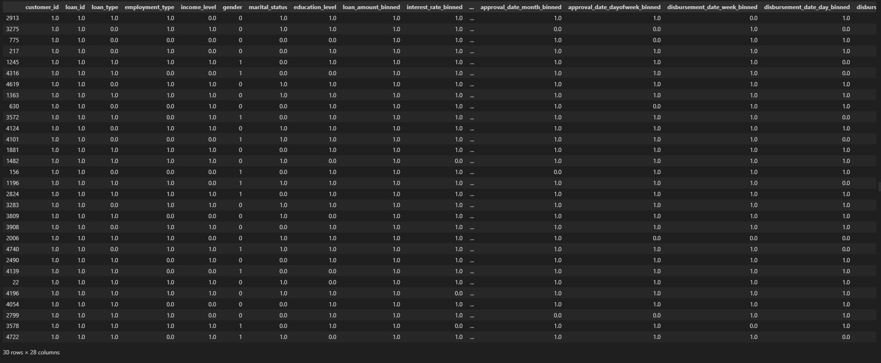
Splitting the Dataset – Training
X_train.head(30)

Slide 34
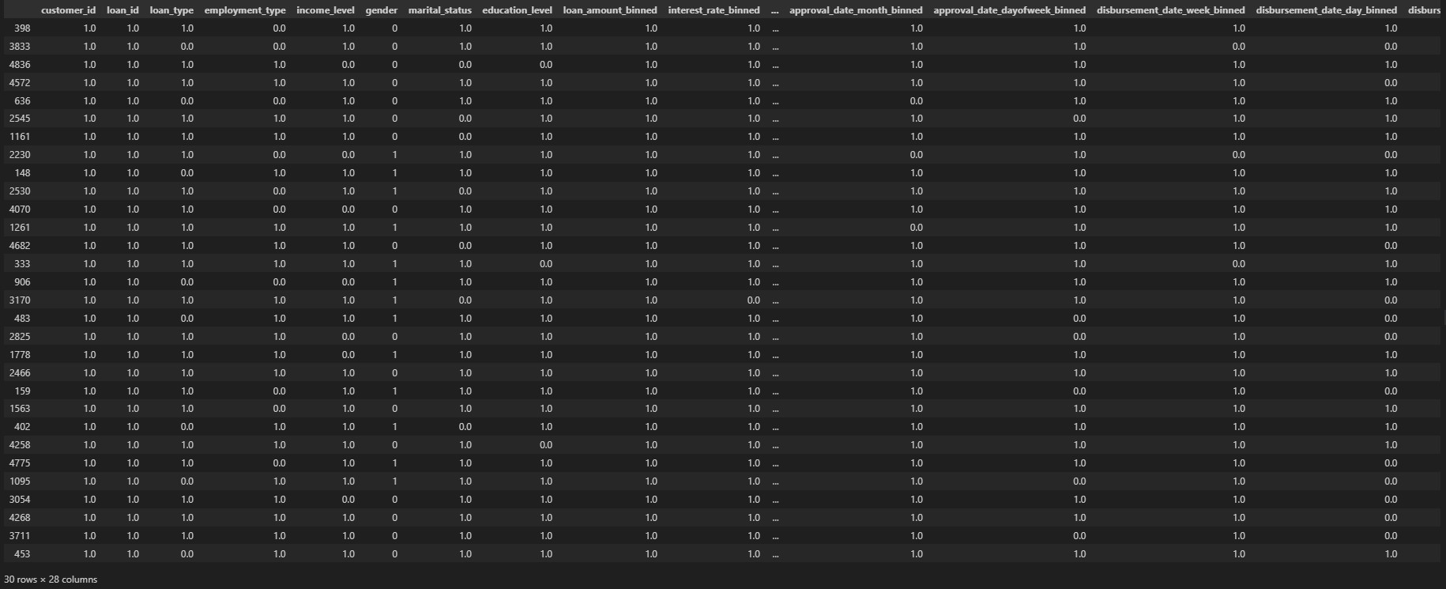
Splitting the Dataset – Testing
X_test.head(30)

Slide 35
SMOTE Techniques
#SMOTE Techniques
#Since the number of 'Non-Defaulters' is more than 'Defaulters', oversampling is carried out to avoid overfitting.
from imblearn.over_sampling import SMOTE
X_train, y_train = SMOTE().fit_resample(X_train, y_train)
from sklearn.metrics import confusion_matrix
from sklearn.metrics import classification_report

Slide 36
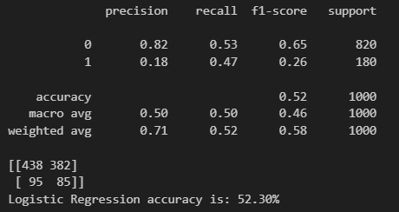
Maching Learning Models – Logistic Regression
#Using differents methods of Machine Learning Models and predictions :
#Logistic Regression
from sklearn.linear_model import LogisticRegression
LRclassifier = LogisticRegression(solver='liblinear', max_iter=5000)
LRclassifier.fit(X_train, y_train)
y_pred = LRclassifier.predict(X_test)
print(classification_report(y_test, y_pred))
print(confusion_matrix(y_test, y_pred))
from sklearn.metrics import accuracy_score
LRAcc = accuracy_score(y_pred,y_test)
print('Logistic Regression accuracy is: {:.2f}%'.format(LRAcc*100))

Slide 37
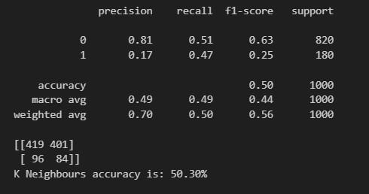
Maching Learning Models – K-Neighbours
#K-Neigbors
from sklearn.neighbors import KNeighborsClassifier
KNclassifier = KNeighborsClassifier(n_neighbors=20)
KNclassifier.fit(X_train, y_train)
y_pred = KNclassifier.predict(X_test)
print(classification_report(y_test, y_pred))
print(confusion_matrix(y_test, y_pred))
from sklearn.metrics import accuracy_score
KNAcc = accuracy_score(y_pred,y_test)
print('K Neighbours accuracy is: {:.2f}%'.format(KNAcc*100))

Slide 38
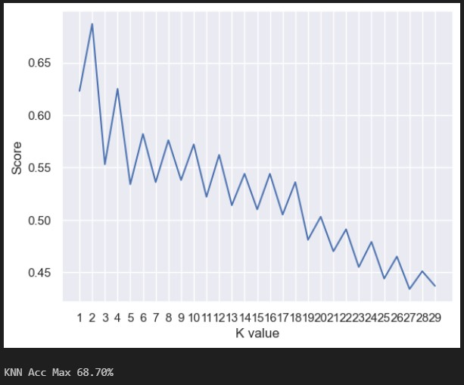
Maching Learning Models – KNN Max
#KNN Max
scoreListknn = []
for i in range(1,30):
KNclassifier = KNeighborsClassifier(n_neighbors = i)
KNclassifier.fit(X_train, y_train)
scoreListknn.append(KNclassifier.score(X_test, y_test))
plt.plot(range(1,30), scoreListknn)
plt.xticks(np.arange(1,30,1))
plt.xlabel("K value")
plt.ylabel("Score")
plt.show()
KNAccMax = max(scoreListknn)
print("KNN Acc Max {:.2f}%".format(KNAccMax*100))

Slide 39
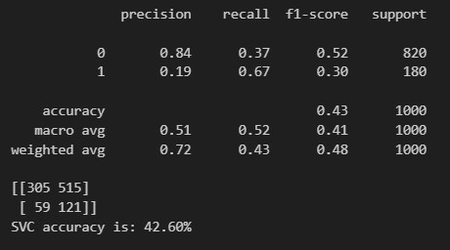
Maching Learning Models – SVM
#Support Vector Machine (SVM)
from sklearn.svm import SVC
SVCclassifier = SVC(kernel='linear', max_iter=251)
SVCclassifier.fit(X_train, y_train)
y_pred = SVCclassifier.predict(X_test)
print(classification_report(y_test, y_pred))
print(confusion_matrix(y_test, y_pred))
from sklearn.metrics import accuracy_score
SVCAcc = accuracy_score(y_pred,y_test)
print('SVC accuracy is: {:.2f}%'.format(SVCAcc*100))

Slide 40
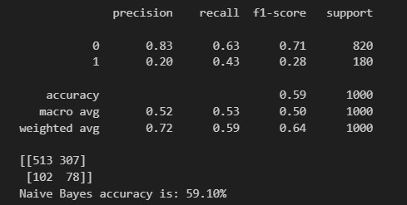
Maching Learning Models – Naïve Bayes
#Naive Bayes Method :
#Categorical NB
from sklearn.naive_bayes import CategoricalNB
NBclassifier1 = CategoricalNB()
NBclassifier1.fit(X_train, y_train)
y_pred = NBclassifier1.predict(X_test)
print(classification_report(y_test, y_pred))
print(confusion_matrix(y_test, y_pred))
from sklearn.metrics import accuracy_score
NBAcc1 = accuracy_score(y_pred,y_test)
print('Naive Bayes accuracy is: {:.2f}%'.format(NBAcc1*100))

Slide 41
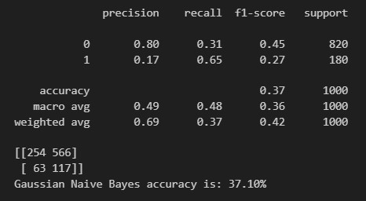
Maching Learning Models – Gaussian Naïve Bayes
#Gaussian NB
from sklearn.naive_bayes import GaussianNB
NBclassifier2 = GaussianNB()
NBclassifier2.fit(X_train, y_train)
y_pred = NBclassifier2.predict(X_test)
print(classification_report(y_test, y_pred))
print(confusion_matrix(y_test, y_pred))
from sklearn.metrics import accuracy_score
NBAcc2 = accuracy_score(y_pred,y_test)
print('Gaussian Naive Bayes accuracy is: {:.2f}%'.format(NBAcc2*100))

Slide 42
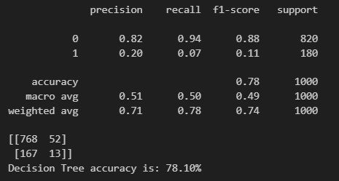
Maching Learning Models – Decision Tree
# Decision Tree
from sklearn.tree import DecisionTreeClassifier
DTclassifier = DecisionTreeClassifier(max_leaf_nodes=30)
DTclassifier.fit(X_train, y_train)
y_pred = DTclassifier.predict(X_test)
print(classification_report(y_test, y_pred))
print(confusion_matrix(y_test, y_pred))
from sklearn.metrics import accuracy_score
DTAcc = accuracy_score(y_pred,y_test)
print('Decision Tree accuracy is: {:.2f}%'.format(DTAcc*100))

Slide 43
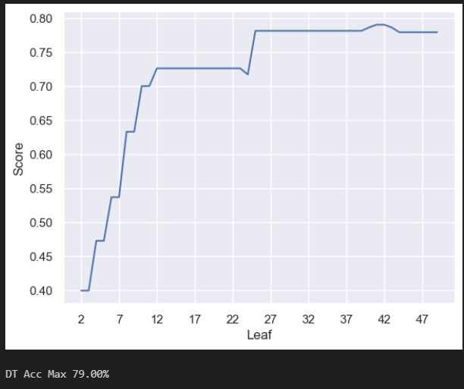
Maching Learning Models – Decision Tree Max
#Decision Tree Max
scoreListDT = []
for i in range(2,50):
DTclassifier = DecisionTreeClassifier(max_leaf_nodes=i)
DTclassifier.fit(X_train, y_train)
scoreListDT.append(DTclassifier.score(X_test, y_test))
plt.plot(range(2,50), scoreListDT)
plt.xticks(np.arange(2,50,5))
plt.xlabel("Leaf")
plt.ylabel("Score")
plt.show()
DTAccMax = max(scoreListDT)
print("DT Acc Max {:.2f}%".format(DTAccMax*100))

Slide 44
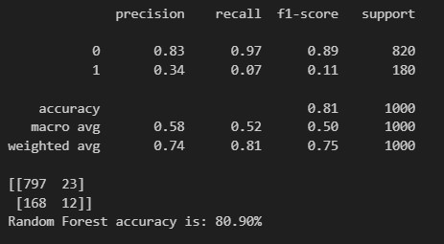
Maching Learning Models – Random Forest
# Random Forest
from sklearn.ensemble import RandomForestClassifier
RFclassifier = RandomForestClassifier(max_leaf_nodes=150)
RFclassifier.fit(X_train, y_train)
y_pred = RFclassifier.predict(X_test)
print(classification_report(y_test, y_pred))
print(confusion_matrix(y_test, y_pred))
from sklearn.metrics import accuracy_score
RFAcc = accuracy_score(y_pred,y_test)
print('Random Forest accuracy is: {:.2f}%'.format(RFAcc*100))

Slide 45
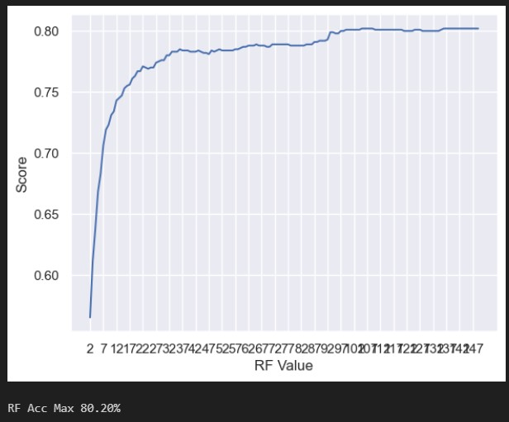
Maching Learning Models – Random Forest Max
# Random Forest Max
scoreListRF = []
for i in range(2,150):
RFclassifier = RandomForestClassifier(n_estimators = 1000, random_state = 1, max_leaf_nodes=i)
RFclassifier.fit(X_train, y_train)
scoreListRF.append(RFclassifier.score(X_test, y_test))
plt.plot(range(2,150), scoreListRF)
plt.xticks(np.arange(2,150,5))
plt.xlabel("RF Value")
plt.ylabel("Score")
plt.show()
RFAccMax = max(scoreListRF)
print("RF Acc Max {:.2f}%".format(RFAccMax*100))

Slide 46
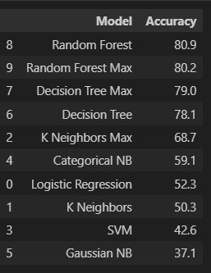
Maching Learning Models Comparison
# Model Comparison
compare = pd.DataFrame({'Model': ['Logistic Regression', 'K Neighbors', 'K Neighbors Max', 'SVM', 'Categorical NB', 'Gaussian NB', 'Decision Tree', 'Decision Tree Max', 'Random Forest', 'Random Forest Max'],
'Accuracy': [LRAcc*100, KNAcc*100, KNAccMax*100, SVCAcc*100, NBAcc1*100, NBAcc2*100, DTAcc*100, DTAccMax*100, RFAcc*100, RFAccMax*100]})
compare.sort_values(by='Accuracy', ascending=False)

Slide 47
Conclusion
Conclusion :
-From the results, it can be seen that Random Forest has the highest accuracy of 80% as compare to the rest of ML models in predicting classification of default status, for the 'Non-Defaulters' on precision, recall and F1-score gives a high score of 83%,97% and 89% and the 'Defaulters' score was 34%,7% and 11% which is lower but able to predict the number of defaulters which is closely comparable to the actual datasets.
-The Decision Tree Classifier has an accuracy above 70% but will select Random Forest as a better ML classifier as the confusion matrix has a better result, and also the precision, recall and F1-score has the highest score.
-Data preparartion like Data Binning need to be specifically done on on numerical and categorical variables which is very important so that ML algorthim will gives a more accuracy in the predictive algorithm techniques used.
In the case of categorical features, we need to perform encoding like onehot encoding so that the ML algorithm can process them more accurately.
-Predicting Loan Default is highly dependent on the demographics of the people, Self-employed/Part-timers with lower income and higher education level are more likely to default on loans.Majority are males.

